Slide 1
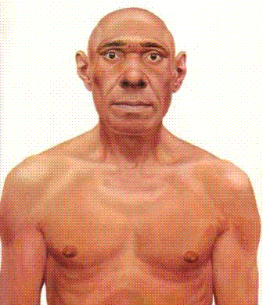
Homo Bro’s

Slide 2
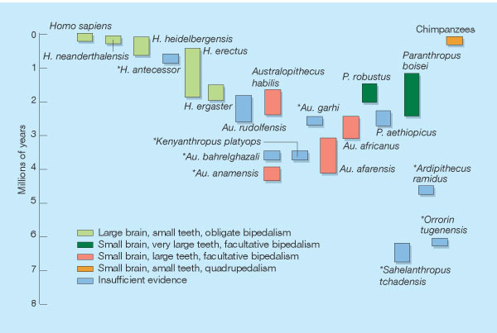
The story so far ..
The known fossil record of hominids, including S. tchadensis, also showing ourselves (top left) and the chimpanzee (top right). NB The species marked with an asterisk were all unknown a decade or so ago.
Species are assigned to one of four categories, based on brain and cheek-tooth size, and inferred posture and locomotion. A fifth category is for 'insufficient evidence'.
Wood, B. (2002) Palaeoanthropology: Hominid revelations from Chad Nature 418, 133–135

Slide 3
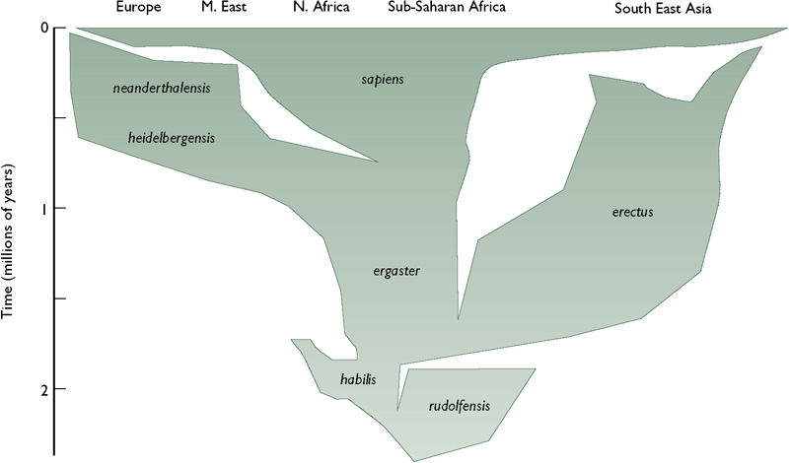
An overview of the evolution of Homo in time and space
Lewin & Foley (2003) Figure 13.1

Slide 4
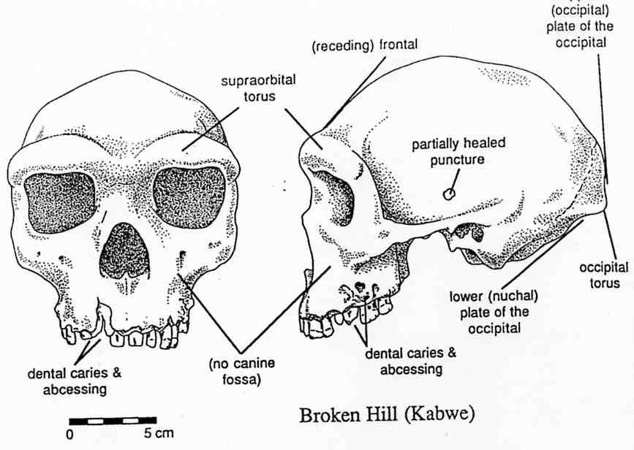
After Homo erectus in Africa
This drawing of the Kabwe cranium from Klein (1999) shows some of the main features of this skull. In its massive face, thick browridges, flat, receding frontal and greater breadth at the base of the skull, it looks more like Homo erectus. But the size of the braincase – at 1280cc – is larger than H. erectus and the back of the skull is differently shaped, with the occipital plate rising nearly vertically above the torus.
The other marked feature of this individual is the shocking state of the teeth, with many caries and abscessing eroding the bone of the upper jaw.

Slide 5
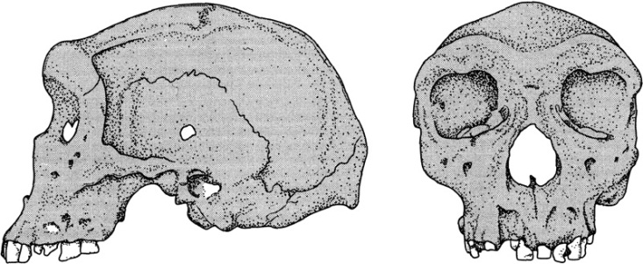
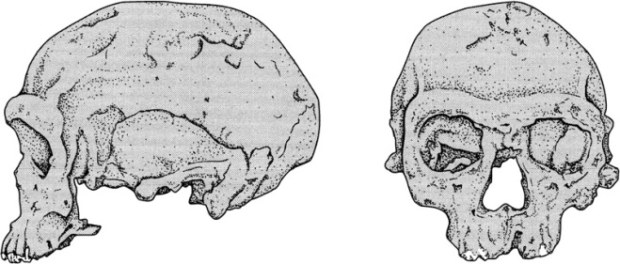
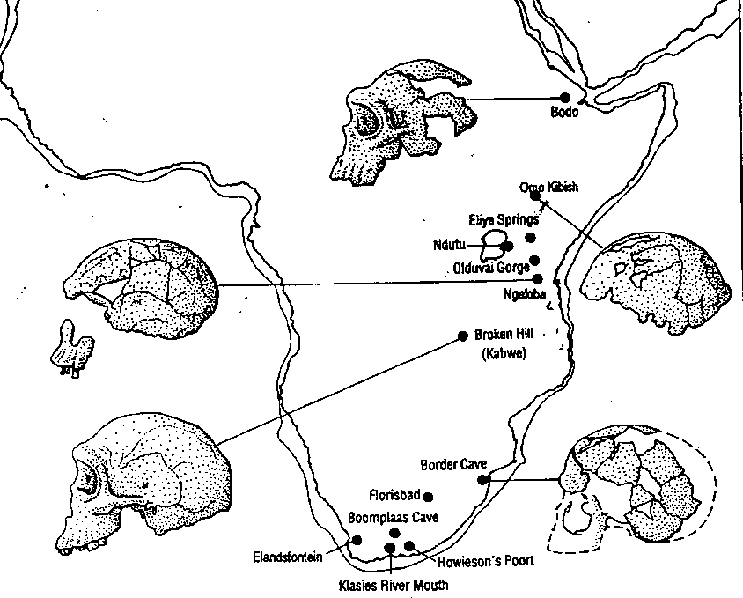
After Homo erectus in Africa - 2
Kabwe
As well as the Kabwe cranium which is of uncertain date, but older than 200ky, there are a number of other similarly archaic fossils (see map: Elandsfontein, Bodo, Ndutu). These fossils are often grouped into Homo heidelbergensis because of their overall similarity with European finds such as Petralona.
In Africa there is then a slightly later group of fossils, including Jebel Irhoud (bottom) which appear to be more modern in character. These include the finds from Florisbad, Ngaloba, Koobi Fora and Omo II (see map). It isn’t clear whether these should be included in H. heidelbergensis, put into a separate species or considered to be very early H. sapiens.
Jebel Irhoud
Drawings from Lewin & Foley (2003)
Map from Stringer & Gamble (1993) In Search of the Neanderthals. Thames & Hudson

Slide 6
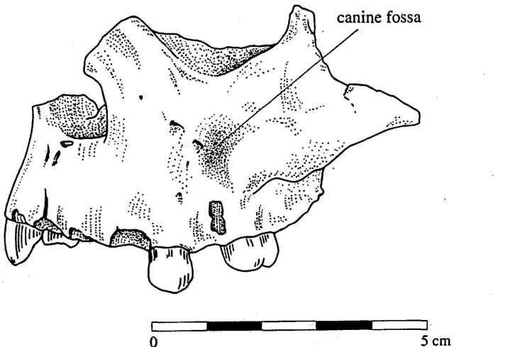
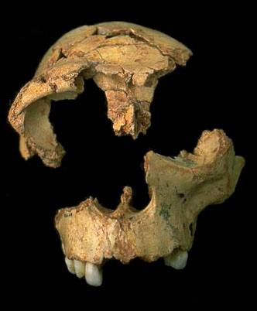
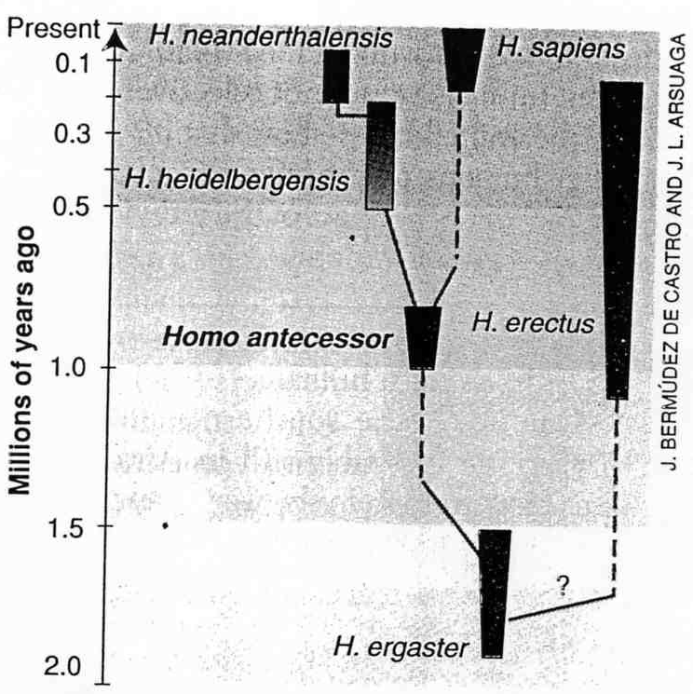
Gran Dolina (TD6), Atapuerca, Spain Homo antecessor – 800ky
Drawing of the maxilla from Klein (1999). The presence of a canine fossa makes this fossil distinguishable from Neanderthals. It has been argued that this is a distinct species (H. antecessor) which is like both H. ergaster and H. sapiens so that it may be a common ancestor to modern humans as well as to the H. heidelbergensis - H. neanderthalensis lineage.
Acceptance of this idea would produce a phylogeny like that shown to the left.
Image from “Atapuerca –
a world heritage site:
http://www.ucm.es/info/paleo
/ata/english/main.htm
deCastro et al (1997) Science 276 1392-5 (Phylogeny from Research news in the same issue)

Slide 7
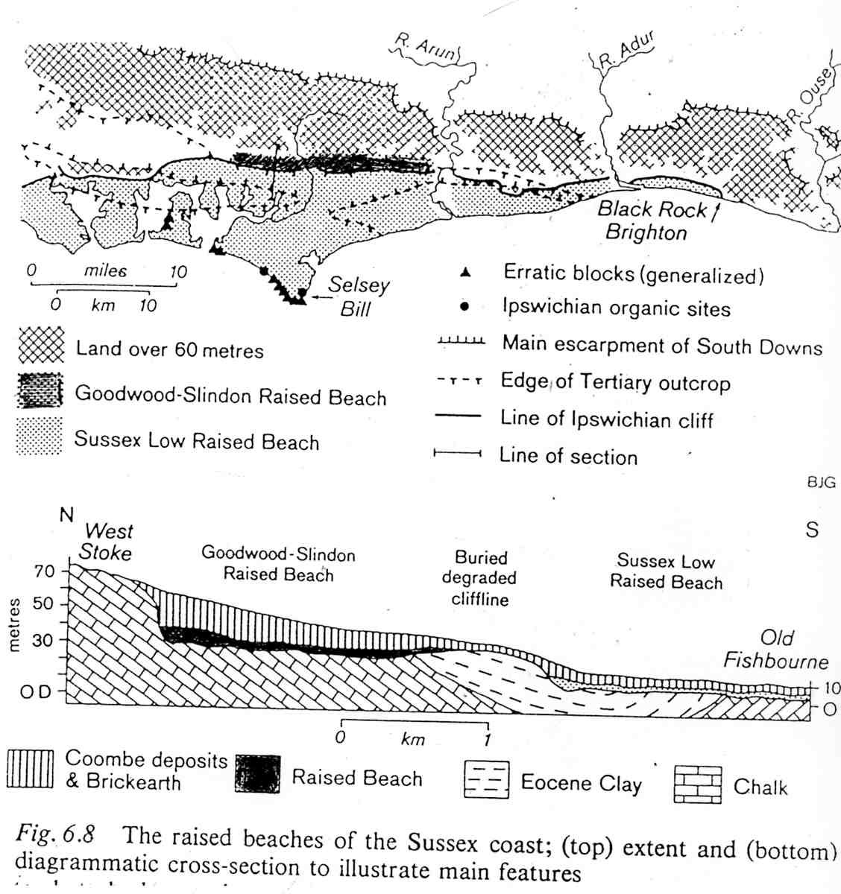
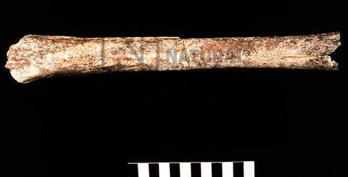
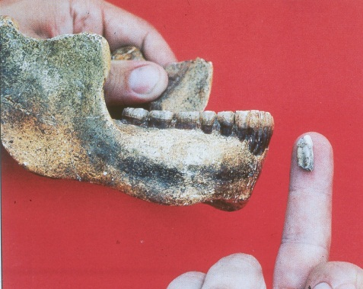
Boxgrove, Sussex - 1
Boxgrove was occupied just before the great Anglian glaciation – about 500,000 years ago.
The people living there were very robustly built.
Because of the similarity to earlier finds they have been placed in Homo heidelbergensis
Jones (1981)
Boxgrove is located on the Goodwood-Slindon Raised beach. Raised beaches are a relic of earlier, higher, sea-levels. In this case, covered by later, cold-stage deposits.
Images of fossils from Natural History Museum.

Slide 8
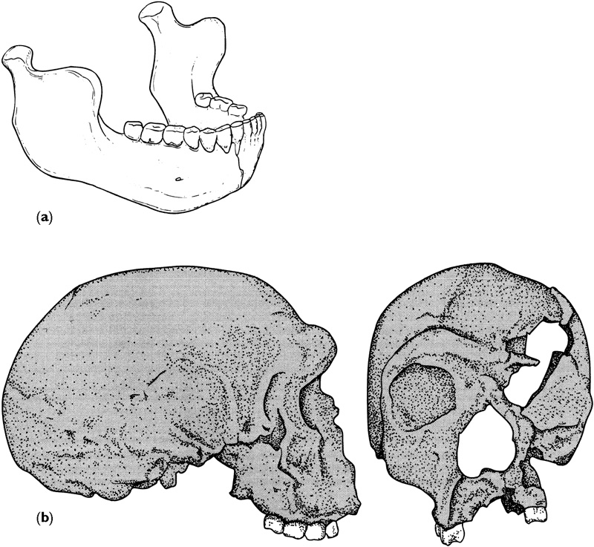
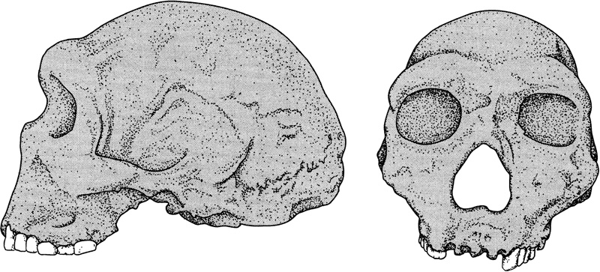
Homo heidelbergensis in Europe
The figure above shows a drawing of the massive skull from Petralona, Greece. This is dated to c. 200ky. Again this combines modern features – the large brain case – with archaic features such as the large face, pronounced brow-ridges and general robusticity. This is currently taken as an example of H. heidelbergensis as it lacks the characteristic mid-facial projection of the Neanderthals.
Illustrations from Lewin & Foley (2003)
The figures above show (a) a drawing of the mandible found at Mauer (500ky) and (b) the cranium found at Steinheim (200-300ky). Both of these German fossils show a mix of archaic and modern features. Neither are clearly attributable to either H. erectus or H. neanderthalensis. Currently both are attributed to H. heidelbergensis.

Slide 9
Homo heidelbergensis in Africa
This drawing of the Kabwe cranium from Klein (1999) shows some of the main features of this skull. In its massive face, thick brow ridges, flat, receding frontal and greater breadth at the base of the skull, it looks more like Homo erectus. But the size of the braincase – at 1280cc – is larger than H. erectus and the back of the skull is differently shaped, with the occipital plate rising nearly vertically above the torus.
The other marked feature of this individual is the shocking state of the teeth, with many caries and abscessing eroding the bone of the upper jaw.

Slide 10
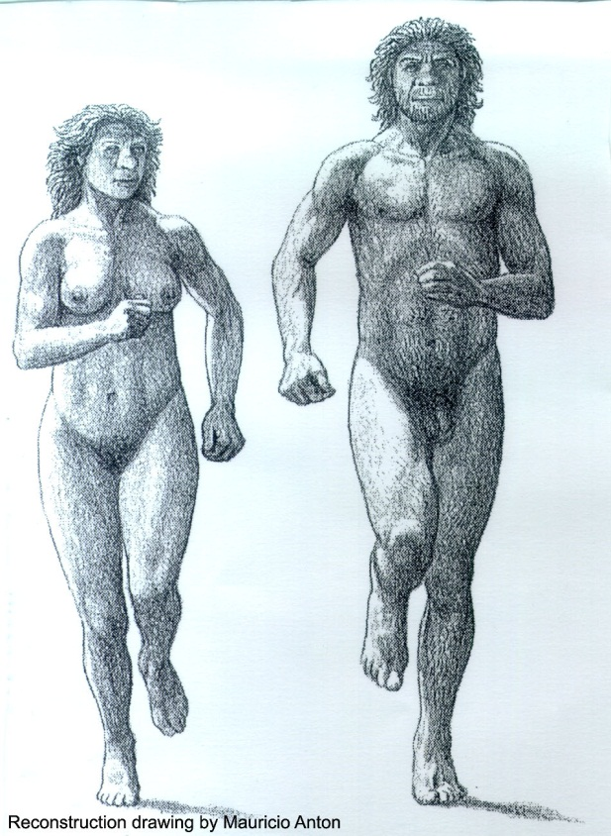
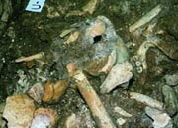
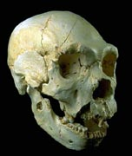
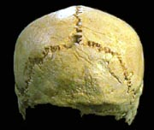
The Pit of the Bones – Sima de los Huesos, Atapuerca
About 300,000 years ago people were living in the area of Atapuerca in Spain
Like the Boxgrove
people, we are
dealing with robust
individuals.
Study of the bones, especially the skulls, from the site suggests that these were very close to the ancestral line of the Neanderthals.
Photos from:
http://www.ucm.es/info/paleo/ata/
english/main.htm

Slide 11
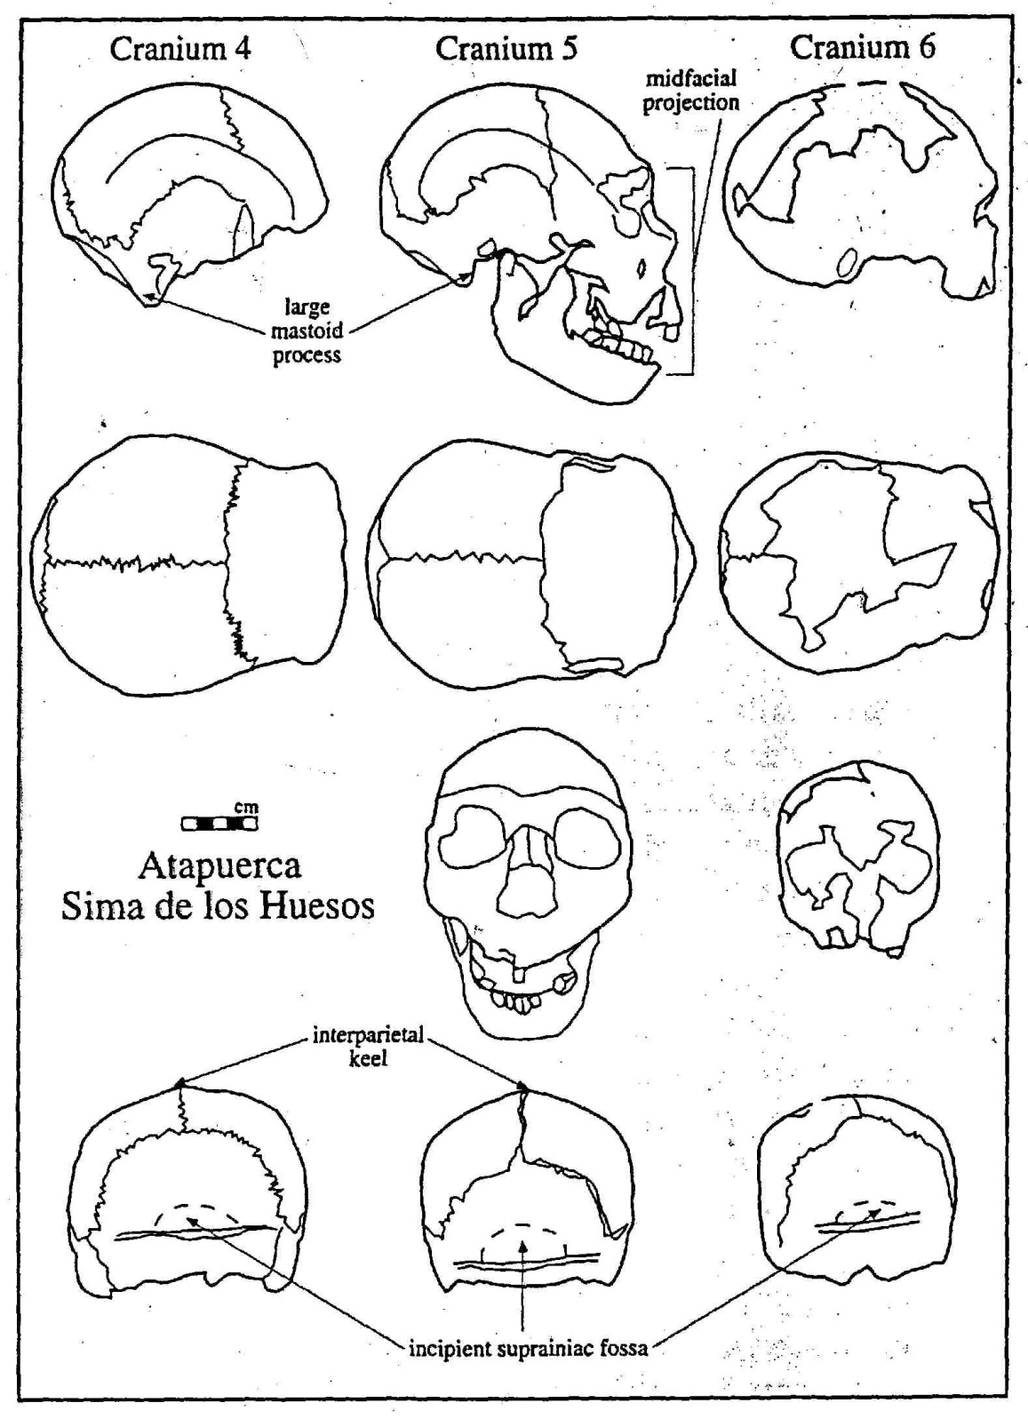
Incipient Neanderthals?
In this diagram from Klein (1999) a number of features on the skulls are indicated.
Some of these features are primitive – the large mastoid process (top row) and the pentagonal shape of the skull as seen from behind (bottom row).
Other features are similar to Neanderthal derived features. These include the midfacial projection in Cranium 5 and the presence of a retromolar space in the lower jaw in this skull (top row). There is also a roughened area, indicated by the dashed line, which lies above the occipital torus, and which anticipates the suprainiac fossa found in Neanderthals (bottom row).
These drawings also show the variability found in this large sample, although it is important to note that Cranium 6 is a juvenile whereas Crania 4 and 5 are adults.

Slide 12
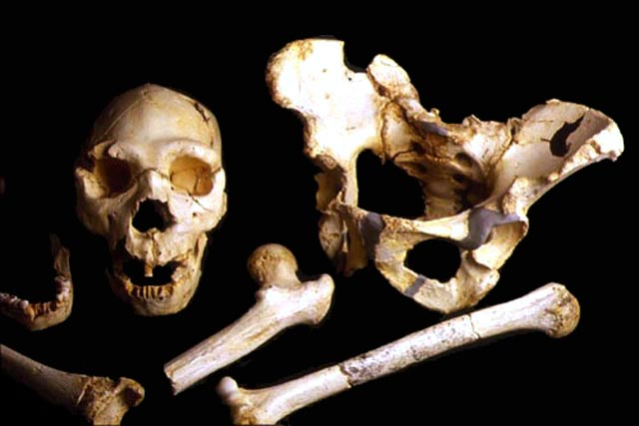
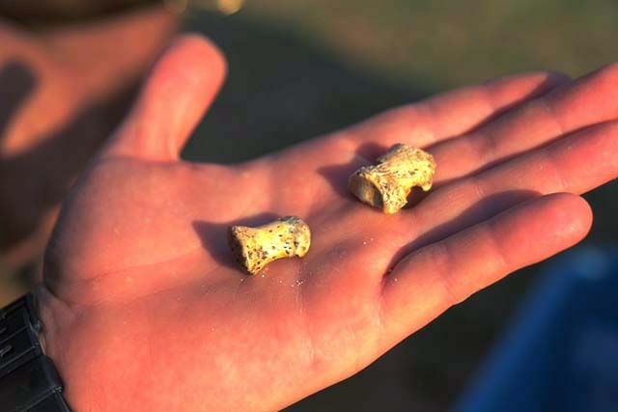
Crania and postcrania from Sima de los Huesos
Left: Mandible, Cranium 5, pelvis and longbones (femur, centre and humerus, right), NB these are shown together but do not belong to the same individual.
Right: The two phalanges shown here are clearly very much more robust than those belonging to the modern human whose hand we see.
Photos from:
http://www.ucm.es/info/paleo/ata/english/main.htm

Slide 13
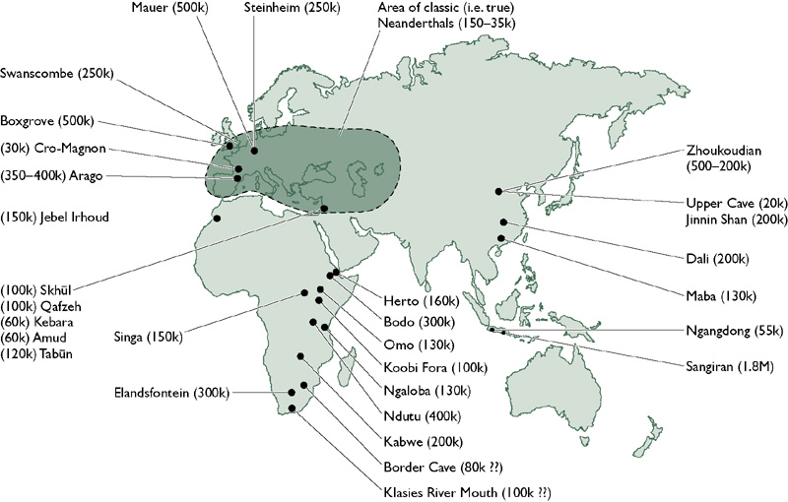
Map of important sites for later hominin evolution
Lewin & Foley (2003) Figure 14.16

Slide 14
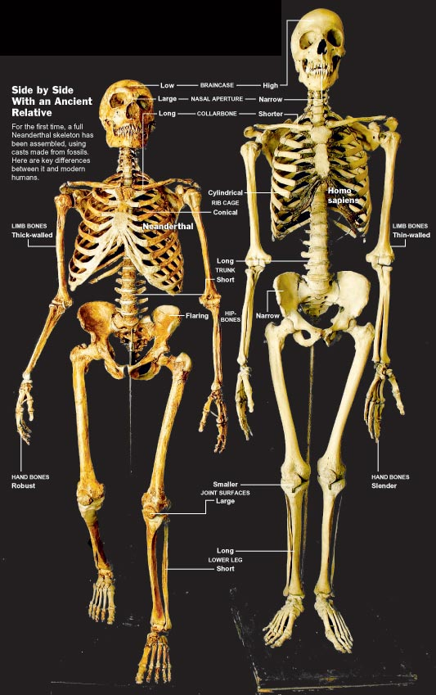
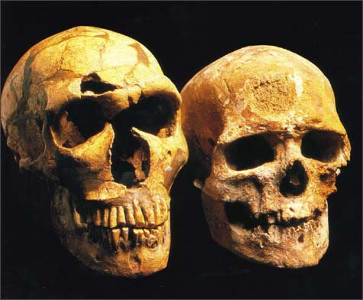
Neanderthals and us
Although Neanderthals are big-brained
bipeds, like us, there are also many
differences in both the skeleton and the
cranium. The question to ask is how
significant these differences are in
taxonomic terms.

Slide 15
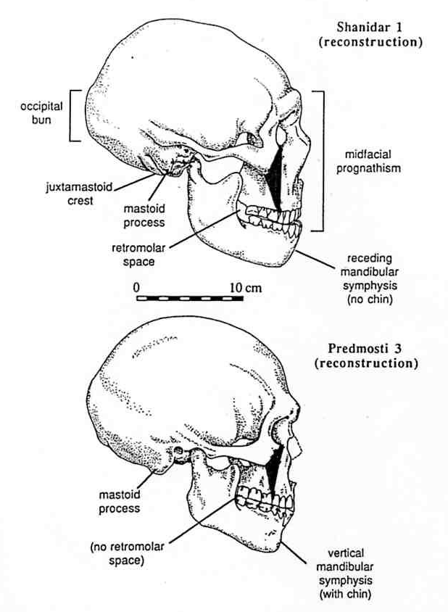
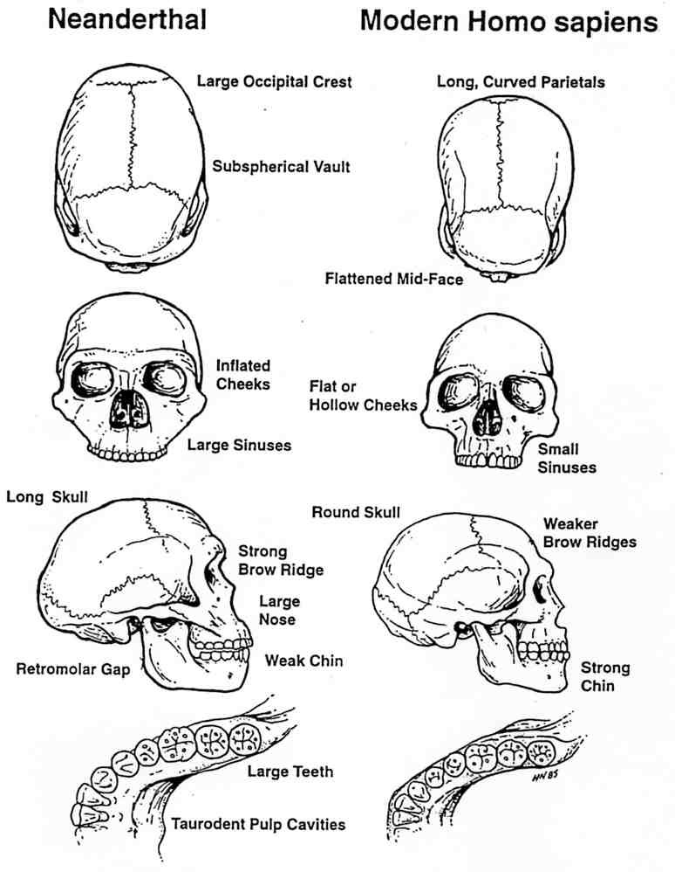
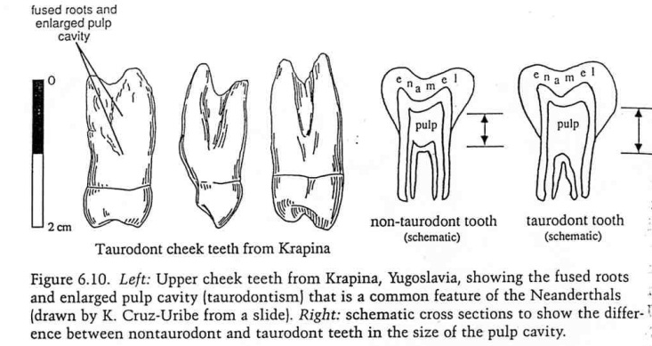
Neanderthal cranial features
Right: Comparison of craniodental traits in Neanderthal and modern humans.
From Fleagle (1999)
Above: Contrasts between the crania of Neanderthal (top) and a robust modern human (bottom).
Note the way in which the middle part of the Neanderthal face juts forward. This is indicated by the wider facial triangle – dark colour – shown projected on the side of the skulls.
From Klein (1999)
From Klein(1999)

Slide 16
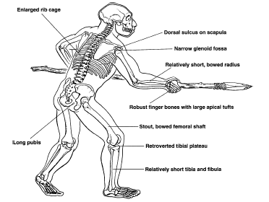
Neanderthal postcranial features
Churchill, S.E. (1998) Cold adaptation, heterochrony and Neanderthals. Evolutionary Anthropology 7 46-60
Notes:
Figure 1. Neanderthal skeletons are characterized in part by long, low skulls with occipital buns and suprainiac fossae, enlarged juxtamastoid eminences, and large, double-arched brow ridges; faces which are pulled forward with large nasal apertures and swept-back cheek bones; and chinless mandibles with spaces behind the last molars. Postcranially, their skeletons have large torsos with long clavicles, broad scapulae, expanded rib cages and wide pelves with long pubic bones. Limb-bones are robust with large joint surfaces. The lower lower limbs are short.

Slide 17
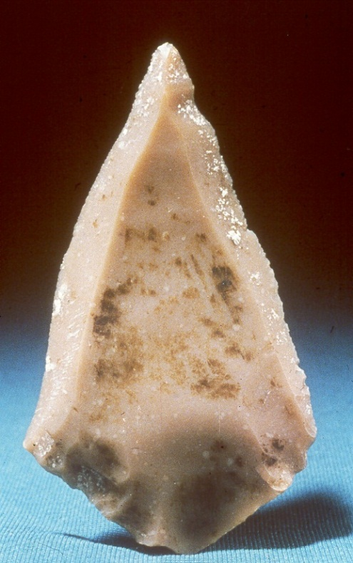
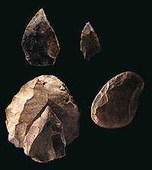
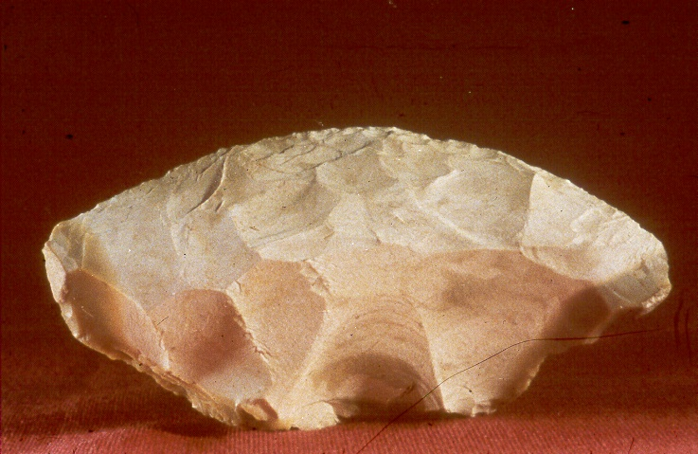
Examples of Mousterian tools
Below – a collection of tools including, bottom left, a Levallois core and refitted flake.
Right (top) – a Levallois point;
Right (bottom) – a side scraper with retouch visible on the upper surface which would have been the working edge.

Slide 18
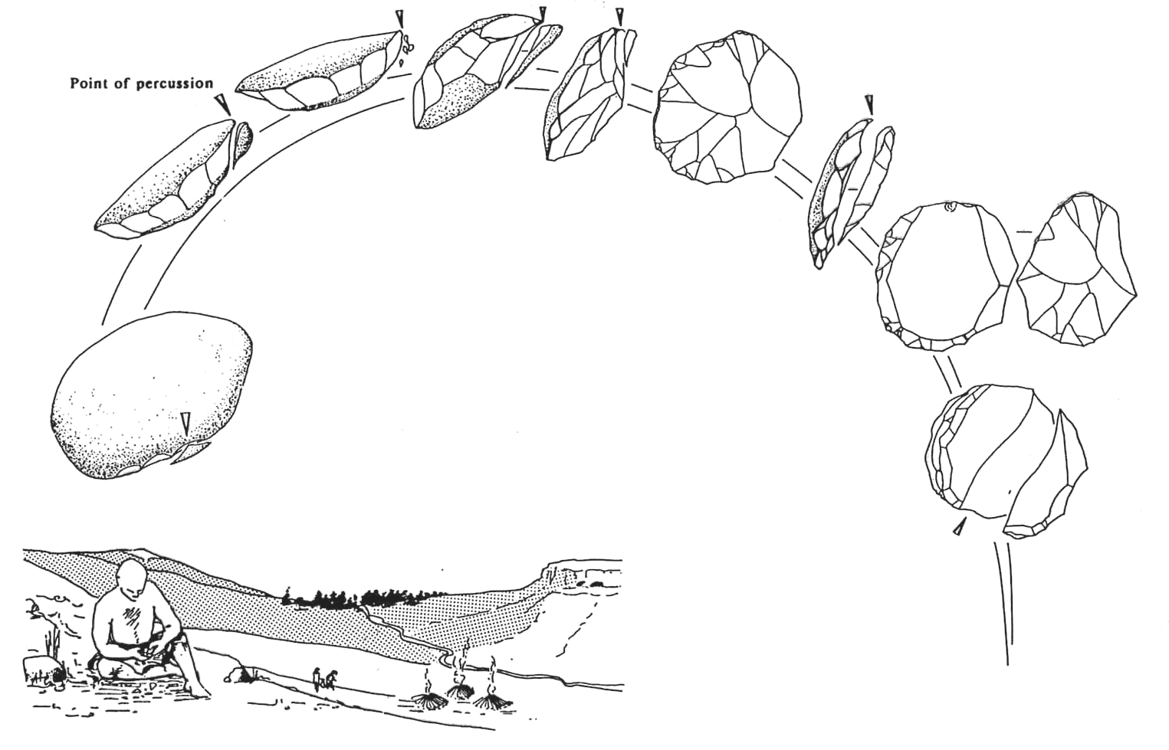
How to make a Levallois point
This diagram shows the sequence of actions taken by a knapper in making a Levallois point, or other tool. The arrows show the point where the core is struck during working. The distinctive feature of the Levallois technique is that the knapper has to go through a lengthy sequence of precise actions to detach a flake of determined (and desired?) shape, but only after the final blow is struck can that shape be seen.
Image from Gamble (1999) The Palaeolithic Societies of Europe. CUP

Slide 19

Neanderthal tooth wear
This close-up view of the dentition of Shanidar 1 shows the marked rounded wear on the incisors which is typical of Neanderthals. The teeth are worn on the surface of the teeth towards the lips and this wear curves away from the biting (occlusal) surface of the teeth. Similar wear is known on the teeth of people who use their teeth as a clamp for working a tough material such as hide. In addition the retromolar space is labelled.
From Klein (1999)

Slide 20
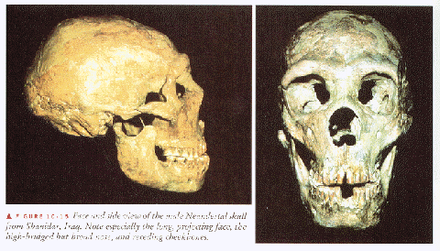
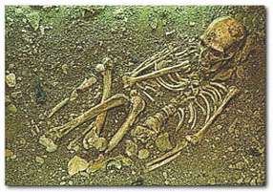
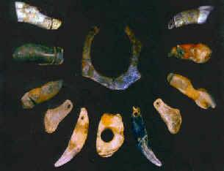
Another way of being human?
Neanderthal skeletons show lots of injuries – which they survived, e.g. Shanidar.
Neanderthals buried their dead.
Neanderthals made sophisticated stone tools.

Slide 21
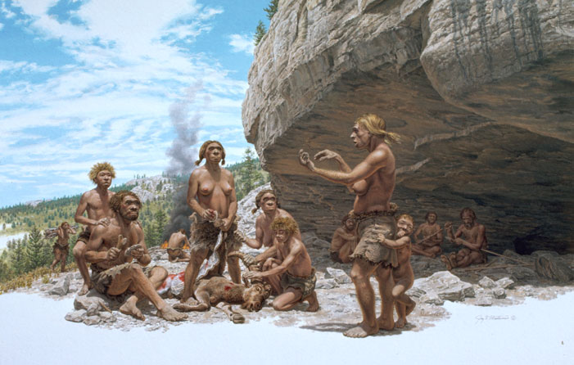
A positive image for Neanderthals?
Jay Matternes (1982) Neanderthals in the Pyrenees
Image from: http://www.jay-matternes.com/Ho09.html

Slide 22
Denisovians
Denisovians were a type of hominin that are known from only a two teeth, a toe bone and a finger bone from which DNA has been extracted. A full DNA profile has been made
The fossils come from a cave in Siberia
They were probably very robust, large individuals

Slide 23
Sometime before 500,000 years ago, probably in Africa, the ancestors of modern humans split off from Homo heidelbergensis While our ancestors stayed in Africa, the (H.h.) common ancestor of Neanderthals and Denisovans migrated out. Those two lineages later diverged, with the Neanderthals initially moving west into Europe and the Denisovans spreading east, perhaps eventually populating large parts of the Asian continent.
Later still, when modern humans ventured out of Africa themselves, they encountered Neanderthals in the Middle East and Central Asia, and to a limited extent interbred with them. This mixing most likely occurred between 67,000 and 46,000 years ago. One population of modern humans then continued east into Southeast Asia, where, sometime around 40,000 years ago, they encountered Denisovans. The moderns interbred with them as well and then moved into Australasia, carrying Denisovan DNA

Slide 24
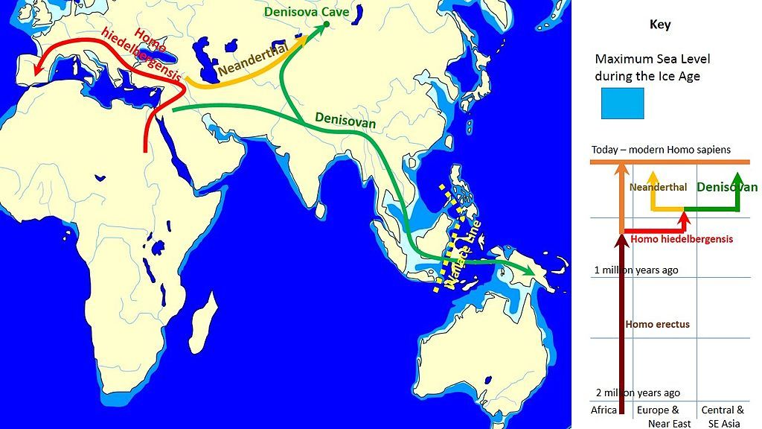

Slide 25
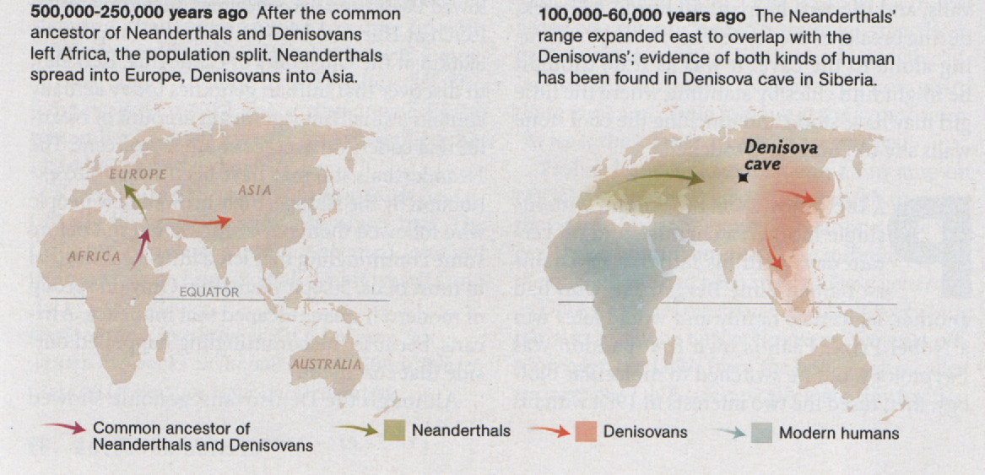

Slide 26
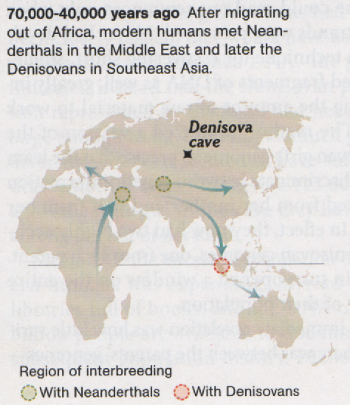
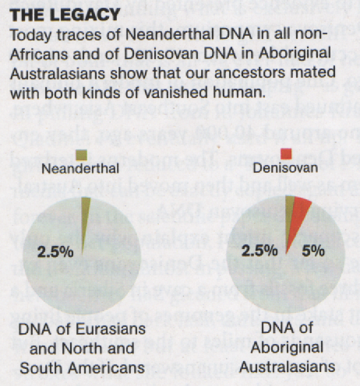

Slide 27
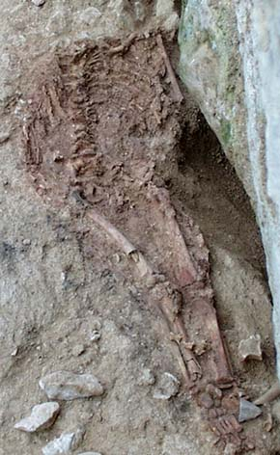
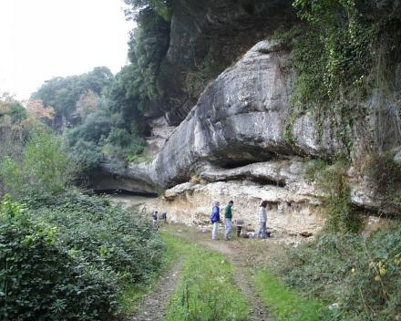
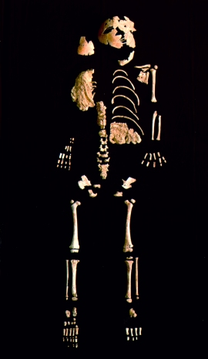
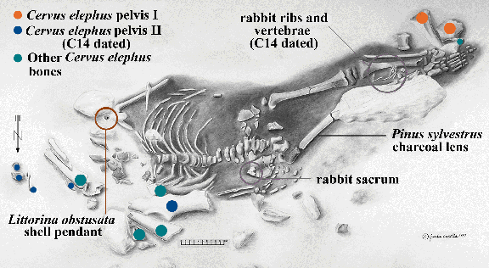
Lagar Velho 24ky
The 4 year-old child’s skeleton after excavation. www.ipa.min-cultura.pt/ pubs/slides/
Lagar Velho rock shelter from the west - www.ipa.min-cultura.pt/ pubs/slides/
Evidence for past interbreeding between Neanderthals & modern humans or simply a stocky Gravettian child?
(Deer)
Lagar Velho burial, above, note the red ochre surrounding the skeleton. Image from: www.artsci.wustl.edu/~anthro/blurb/
b_trink.html
Drawing showing the burial and the presence of “grave goods”. From an article by João Zilhão: www.athenapub.com/ 8zilhao1.htm

Slide 28
